Slide 1
os structures
1. Simple structure
2. Monolithic structure
3. layered approach
4. Micro kernel structure
5. Modular structure

Slide 2
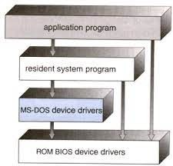
Simple structure (MS-DOS)
There is no well defined structure
everything is placed in single module
in less space we can able to implement the functionality
Here application programs are directly interact with h/w. if application program fails the entire system may fails

Slide 3
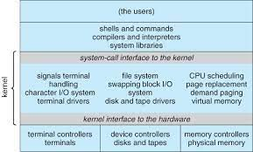
Monolithic structure:(UNIX)
it consists of mainly 2 parts (kernel and system programs)
kernel divided into 2 parts (device drivers and functionalities)
if you want to add extra function to kernel then kernel becomes large and complex because kernel already occupied with many computers

Slide 4
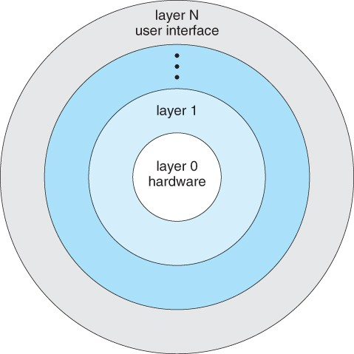
Layered Approach : Window NT,XP,VISTA
In this os structure is divided into n no of layers.
the first layer 0 contains h/w and last layer n contains user.
its difficult to design because more layers.
it contains several modules . each module is a layer
each layer uses the services provided by the lower layer and provides all those services to upper layer.
top most layer not access directly bottom layer
debugging is easy
if layer 2 has problem only that layer was impact not upper an lowe layer.
showing the essential details and hiding the unwanted details called abstraction
layer 1 uses the services of layer 0 but it doesn’t know how to implement layer 0.

Slide 5
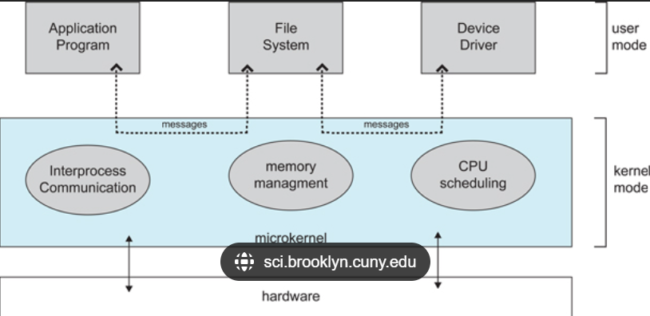
Micro kernel system: mach
in this kernel contains only necessary components.unnecessary components send to the user mode.
one user program can interact with the another user program with the help of IPC.
IPC implements with the help of message passing
Application programs uses os services through IPC only. so burden on kernel is more.

Slide 6
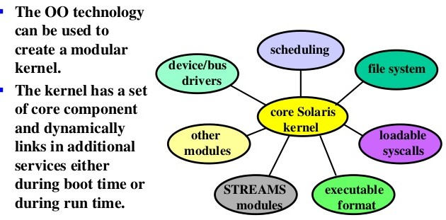
Modular structure(solaris)
in this kernel contains core components and remainig components are added during run time
this is the most efficient approach

Slide 7
os services
Program execution
user interface
i/o operations
file system manipulations
communication
error handling
resource management
protection

Slide 8
Program execution:
program should be loaded into main memory
execute the program
handles the program execution
provides a mechanism for process communication.
provides a mechanism for process sysnchronization
provides a mechanism for deadlock handling
I/O operation:
i/o operation mean read or write operation with any file or any specific i/o device.
os provides the access to the required i/o devices when required.

Slide 9
File system manipulations:
file system is normally organized into directories for easy to navigate and usage
os gives the permission to the program for operation on file
permission may be read,write,read &write
os provides an interface to the user to create/delete a files
os provides an interface to the user to create/delete directories
os provides an interface to create the backup of file.
communication:
os hadles routing and connection strategies.
if 2 processes want to exchange the data those processes can be in one computer or different computer but they are connected through n/w then only they can exchange the data

Slide 10
error handling:
error may occurs in program or h/w
error will be reported to the user
sometimes os will be debug the errors
Resource management:
in multitasking os needs to adjust resources to all processes without conflict.
os manages the all kind of resources using schedulars.
protection:
os provides the authentication feature by providing username &pwd
user interface:
1.CLI
2.GUI

